Slide 1
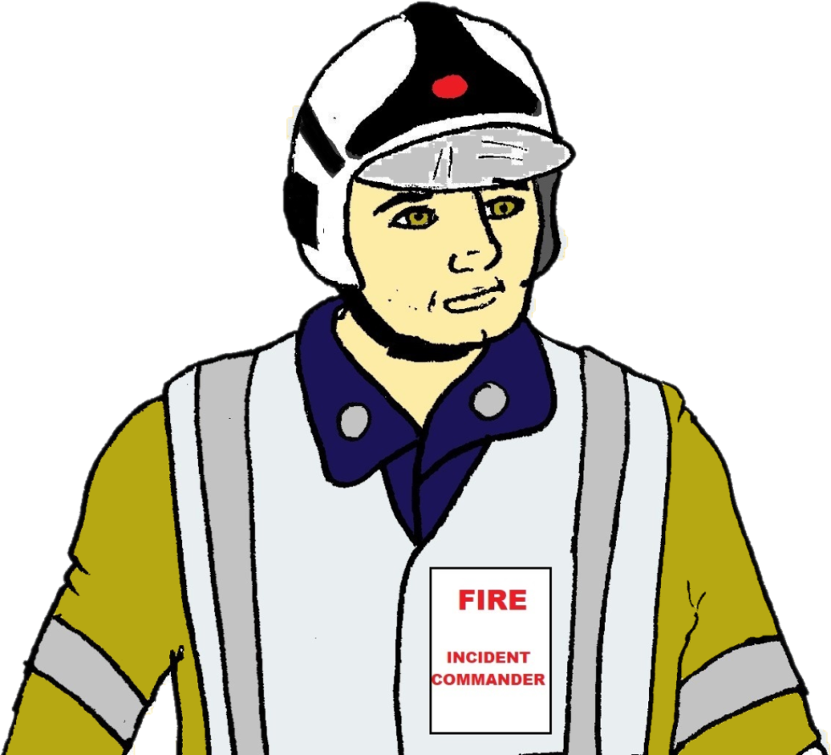
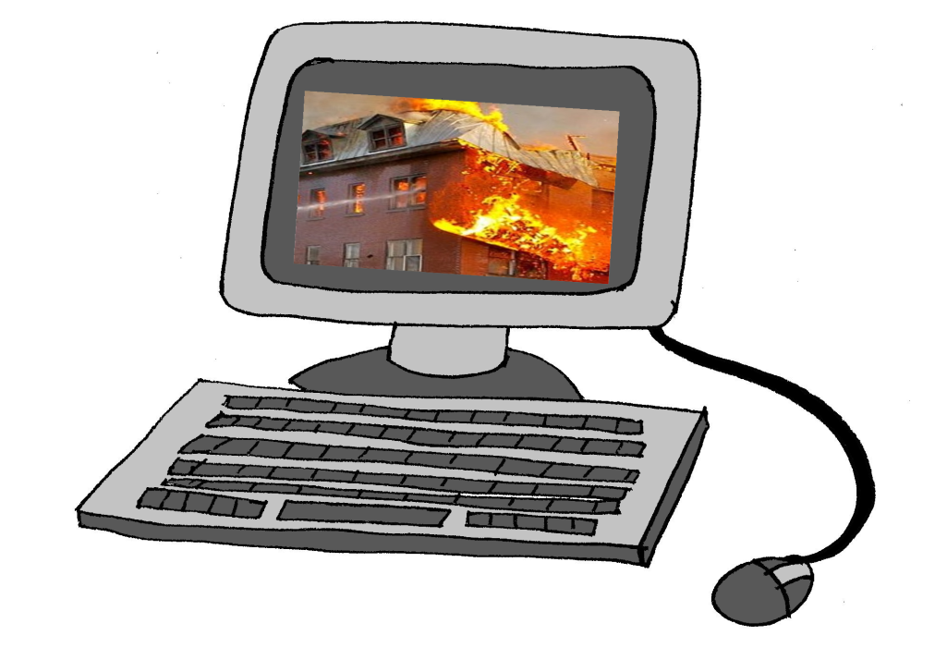
FEEDBACK PRESENTATION/FIGURES FOR
FIREFRONT RESPONDENTS

Slide 2
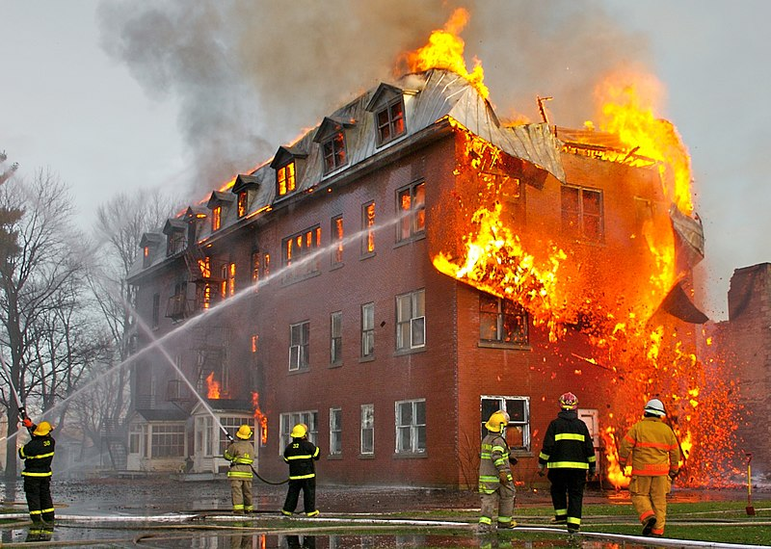
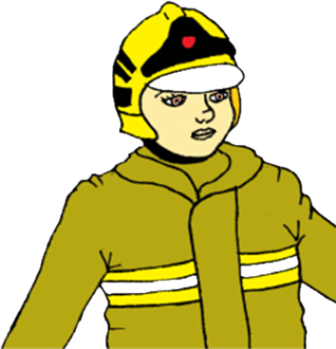
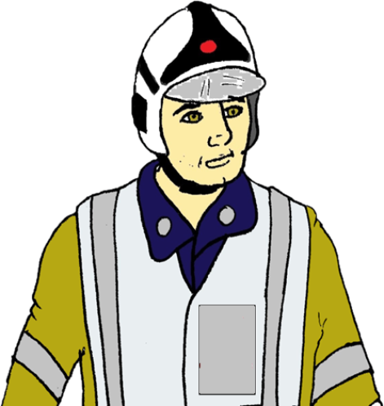
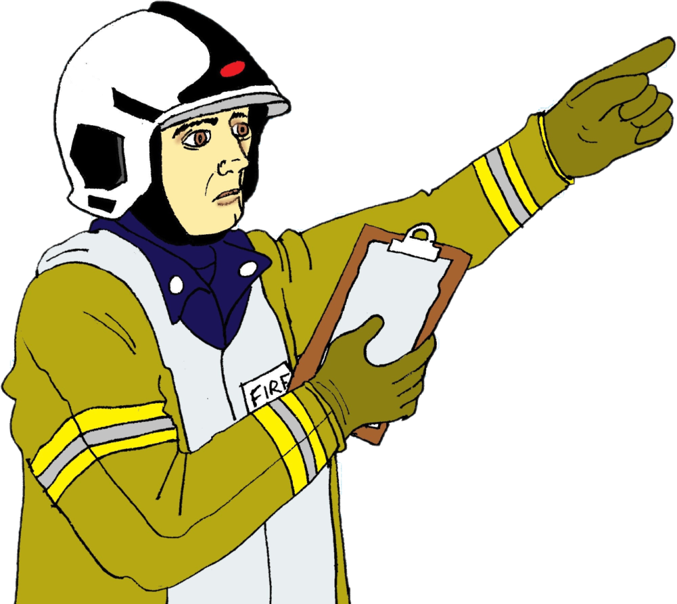
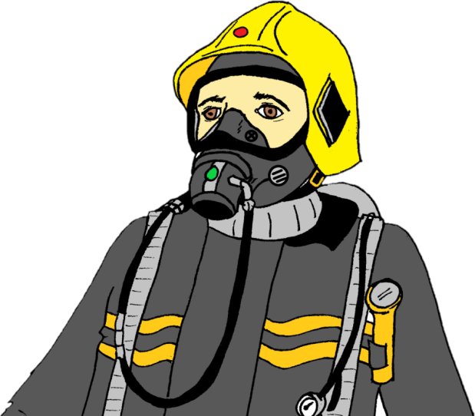
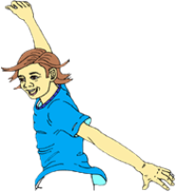
SUMMARY
The
Perception
(acquiring information)
Integration
(sense-making)
Projection
(planning and outcome)
situation
Situation
AWARENESS
What is happening,
where things are…?
Tested using True/False
Statements.
If you know what
is true and what
is false then
you are
aware of the situation.
Situation
UNDERSTANDING
Making sense of the situation,
predicting what will happen,
and planning for a Successful outcome. To do this an understanding of what information is relevant to successful completion of your task is crucial. This understanding is tested by the relevant/irrelevant statements.
Also important to know your perceived situation awareness/
understanding. Tested by the confidence ratings. Is your confidence justified?

Slide 3
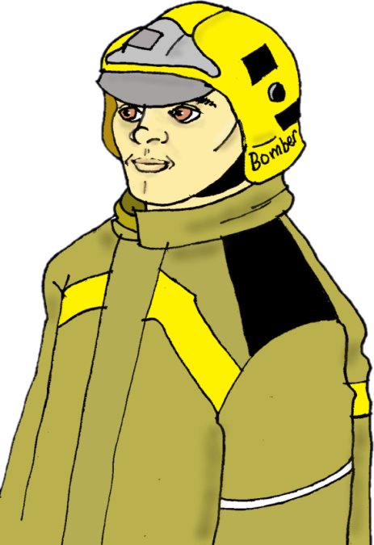
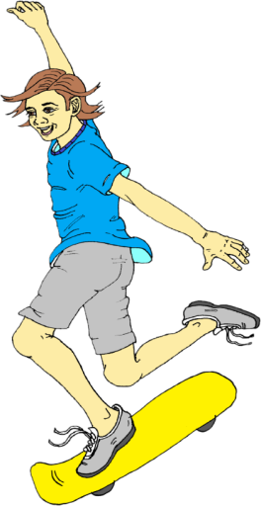
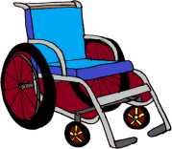
Each Emergency Crew Member collects or takes in “information” about the current situation …

Slide 4
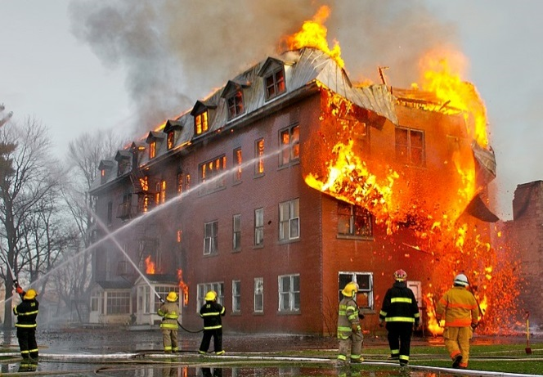
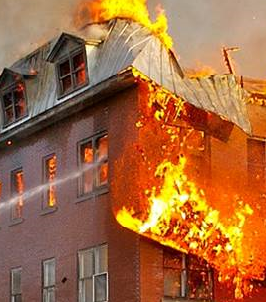
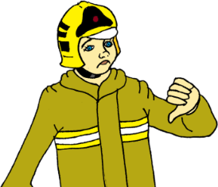
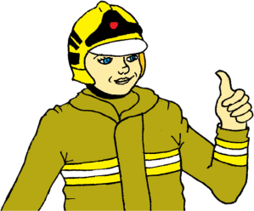
This information helps to make a mental representation or impression of the situation =
the person’s ACTUAL SITUATION AWARENESS (ASA)
Note: ASA may not always match the situation: may be incomplete or wrong. This causes errors.

Slide 5
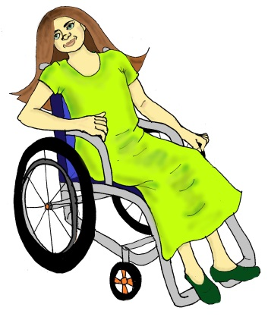
People also use deeper thought & analysis,
possibly using past experience or prior knowledge
to decide what is relevant in the situation:
= ACTUAL SITUATION UNDERSTANDING (ASU)
Note: Individuals may also use reasoning or past knowledge not relevant for the current situation. This can cause decision errors.

Slide 6
The brain can’t process a lot of information at once when making decisions & errors can occur, especially under time pressure or stress

Slide 7
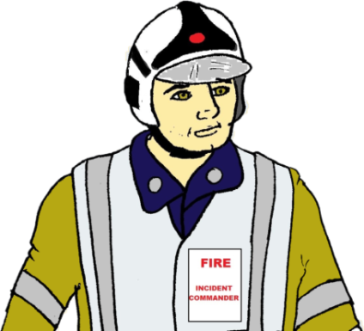
TO COPE WITH INFORMATION, THE BRAIN OFTEN SHOWS “BIAS” WHEN MAKING DECISIONS:
BIAS = a Mental Zoom Lens that either:
(a.) Zooms in on part of the situation (NARROW BIAS):
OR:
(b.) Zooms out or spreads over a wider span of information (BROAD BIAS):

Slide 8
EITHER BIAS IS NOT A PROBLEM IF THE MENTAL FOCUS IS ON the CORRECT INFORMATION AT THE RIGHT TIME…
But especially under stress,
people can show a personal Bias tendency that has a risk of errors…

Slide 9
ZOOM-IN (NARROW) BIAS can lead to overlooking information and to “MISS” ERRORS:
Zoom-in bias
There is a wheelchair next to the building……..Yes? No?
“No!” =
MISS error

Slide 10
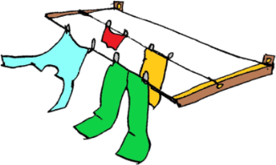
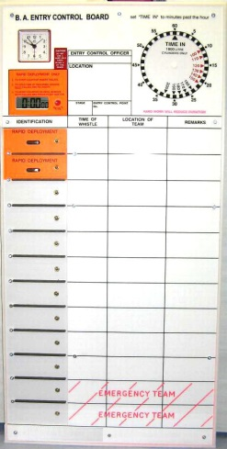
ZOOM-OUT (BROAD) BIAS can cause shallow, superficial or weak processing with poor checking of the information
& risk of “FALSE ALARM” errors
There are TWO children trapped upstairs: Yes? No?
“Yes!” =
False Alarm Error

Slide 11
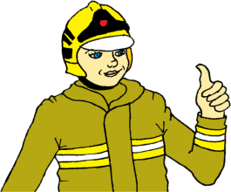
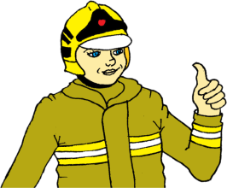
Errors could also occur from a MISMATCH
(1.) between Actual SA and Perceived SA (confidence in SA)
or (2.) between Actual SU and Perceived SU (confidence in SU): e.g.,
ACTUAL SA or ACTUAL SU | PERCEIVED SA or PERCEIVED SU (Personal confidence) | ASA & PSA MATCH? ASU & PSU MATCH? | ERRORS?
high | high | matched | Less likely to make errors
low | high | mismatched | May be overconfident- may not check SA or SU
high | low | mismatched | May be needlessly hesitant to decide or act
low | low | matched | Matched, but may be hesitant, though more justified in this case.

Slide 12
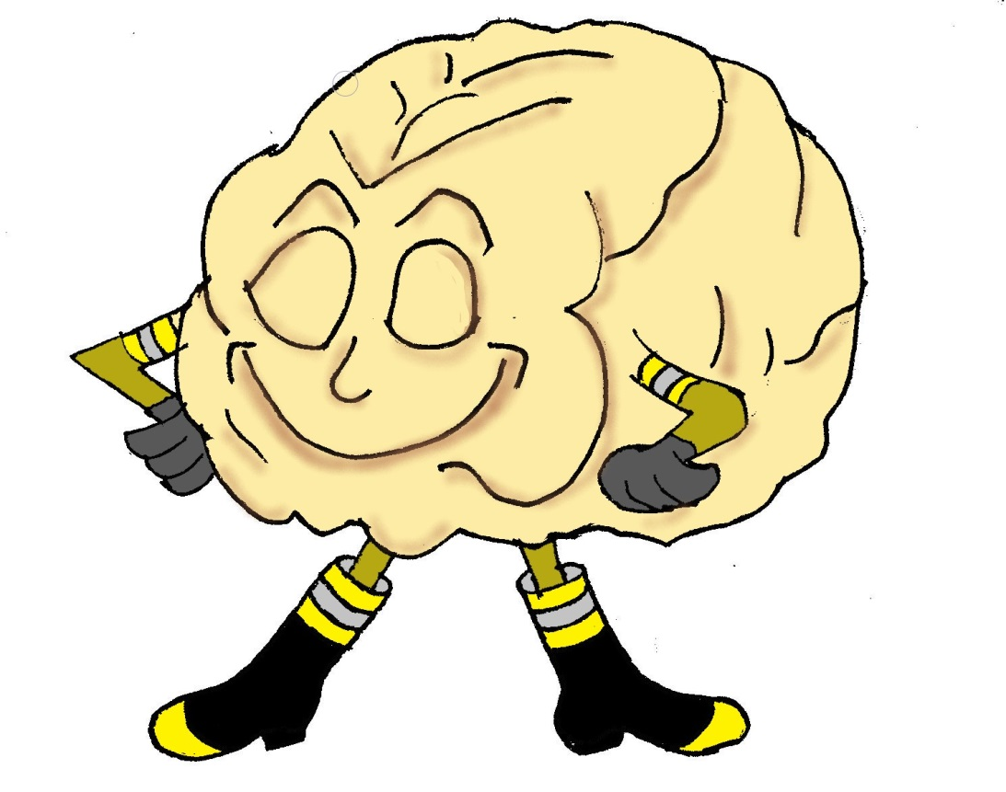
The human brain is a key Fire and Emergency tool.
It has many amazing abilities but
it is also important to be aware of its limits!
All Images by D. Catherwood except the brain-on-fire image purchased from friendlystock.com, brain neural network image purchased from shutterstock.com
and the background fire scene downloaded from Wikipedia

